Slide 1

PROJECT PRESENTATION ON TITANIC DATASET ANALYSIS
PRESENTED BY:-
1)ROHINI RAJENDRA MALI
2)SUJATA CHAUDHARI
GUIDED BY:-
VAISHNAVI KULKARNI MAM

Slide 2
INDEX
INTRODUCTION
GOALS AND OBJECTIVE
SOFTWARE REQUIRED
MACHINE LEARNING STEPS\
DASHBOARD
CONCLUSION

Slide 3
INTRODUCTION
The ship sank in the North Atlantic ocean over one hundred years ago.But almost everybody in the world today knows the name of the titanic. In 1912, the titanic is the biggest ship that was ever built. It is 269 meters long and everyone thinks that the ship is also very safe. The ship can carry more than 3,000 passengers, and has many decks, a swimming pool, a library, Turkish baths, and excellent restaueants and bars. The titanic leaves Southampton, on the south coast of England, on April 10,1912.

Slide 4
DATASET
The sinking of the Titanic is one of the most infamous shipwrecks in history.
On April 15, 1912, during her maiden voyage, the widely considered “unsinkable” RMS Titanic sank after colliding with an iceberg. Unfortunately, there weren’t enough lifeboats for everyone on board, resulting in the death of 1502 out of 2224 passengers and crew.
While there was some element of luck involved in surviving, it seems some groups of people were more likely to survive than others.
In this challenge, we ask you to build a predictive model that answers the question: “what sorts of people were more likely to survive?” using passenger data (ie name, age, gender, socio-economic class, etc).

Slide 5
GOALS AND OBJECTIVE
We take the Data from https://www.kaggle .com/c/titanic/data
The purpose of this project is to document the process I went through to create my predictions for Titanic Survivor Prediction.
The objective of this project was to build a classification model that could successfully determine whether a Titanic passenger lived or died.

Slide 6
SOFTWARE REQUIRED
TOOLS USED
1.Anaconda Navigator - 1.9.6
2.Jupyter Notebook – 5.7.4
LIBRARY USED
1.Analyzing: Pandas,Numpy
2.Visualization: Matplotlib, Seaborn

Slide 7
MACHINE LEARNING STEPS
Preparing The Data
Collecting Data
Choosing The Model
Training The Model
Making Predictions
Result
Evaluating The Model

Slide 8
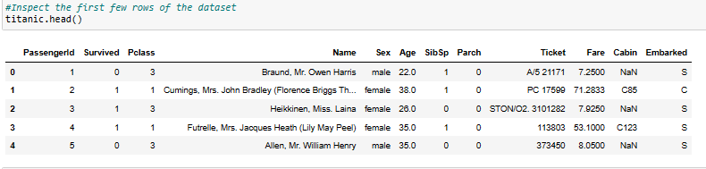
READ THE DATASET

Slide 9
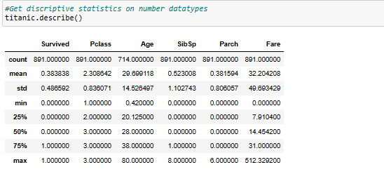
EXPLORE THE DATA

Slide 10
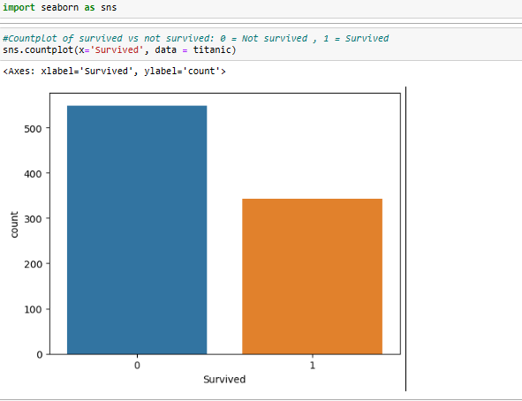
DATA ANALYSIS

Slide 11
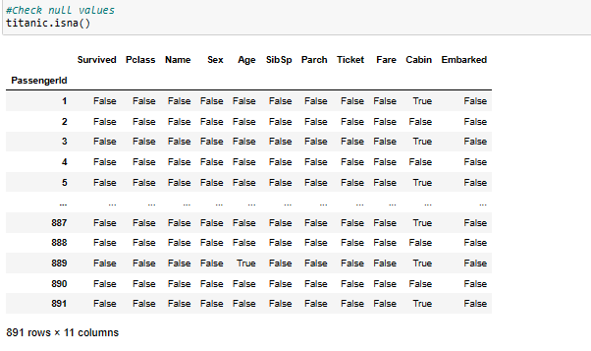
CLEANING AND ANALYSING THE DATA

Slide 12
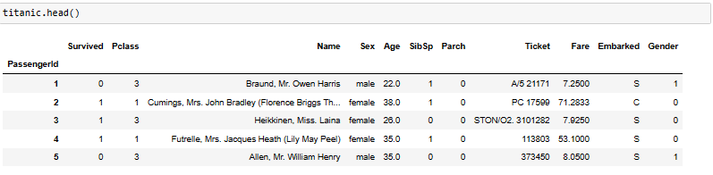
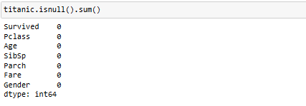

Slide 13
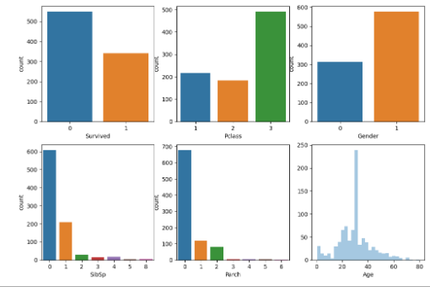
DATA VISUALIZATION

Slide 14
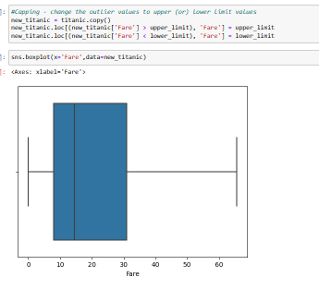
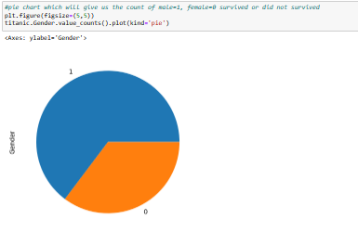
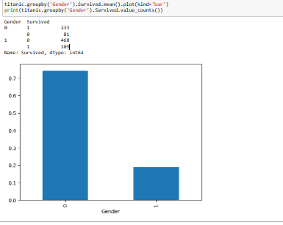
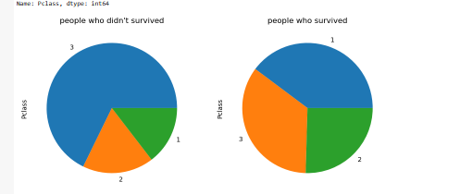
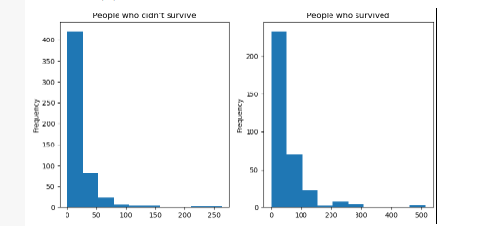

Slide 15
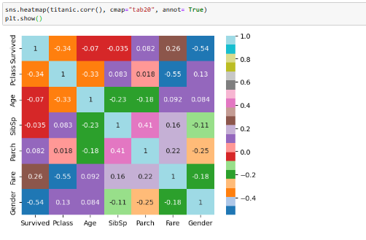
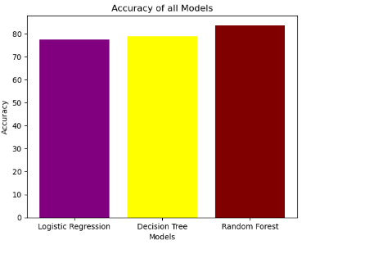
HEATMAP AND ACCURACY SCORE
Model | Accuracy Score
Random Forest | 83.582090
Decision Tree | 78.731343
Logistic Regression | 77.238806

Slide 16
CONCLUSION
I have removed variables like “Name”, “Sex”, “Ticket”, “Embarked”, as they are not effecting the target variable much.
Women, children, and first class passengers as well as people with a small family had a better chance at survival. The Embarked doesn’t seem to have an effect as the percentages are in line with the amount of people embarked from each port.
And I am getting an higest accuracy of 83.58%.

Slide 17
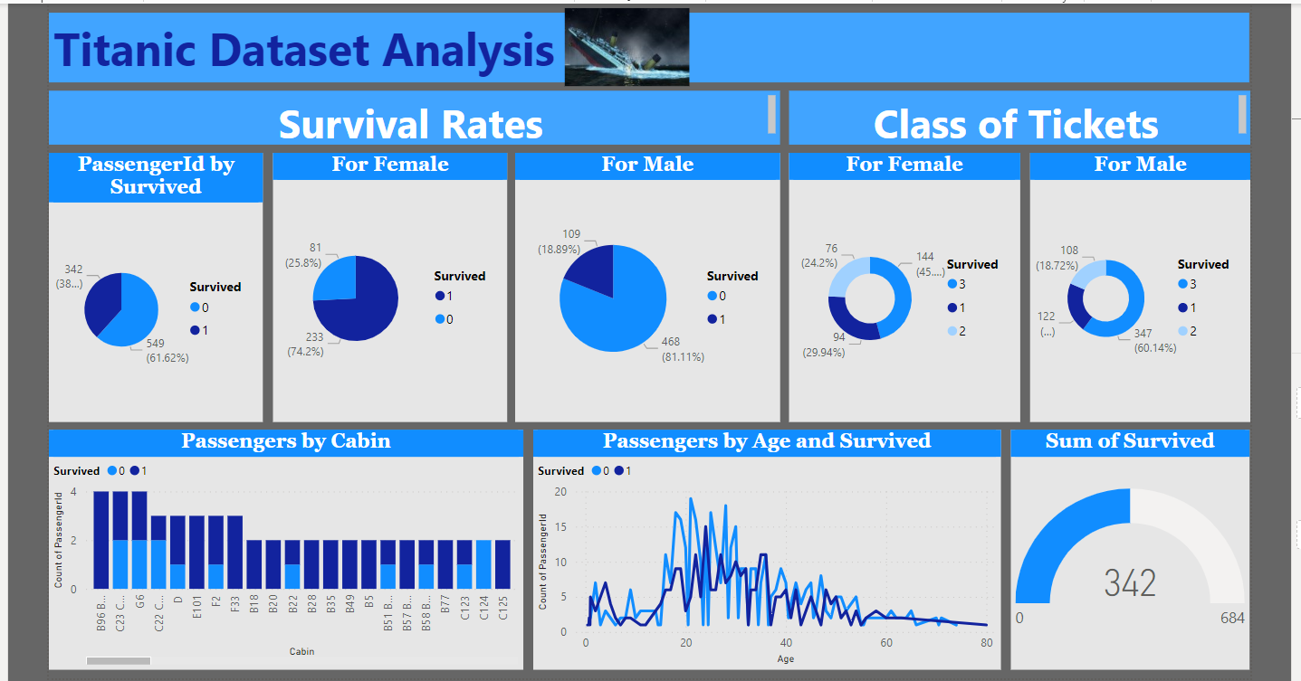
DASHBOARD

Slide 18
THANK YOU

